Slide 1
EDISON TOWNSHIP – Demographics and Land Uses
Demographics, Housing, Contaminations Sites

Slide 2
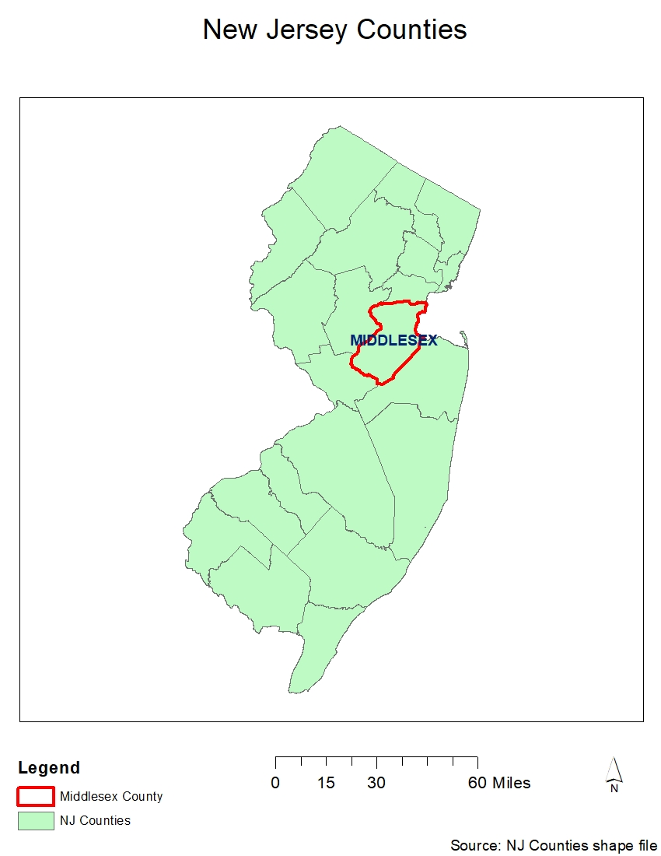
Edison
A municipality in Middlesex County
Named after Thomas Edison

Slide 3
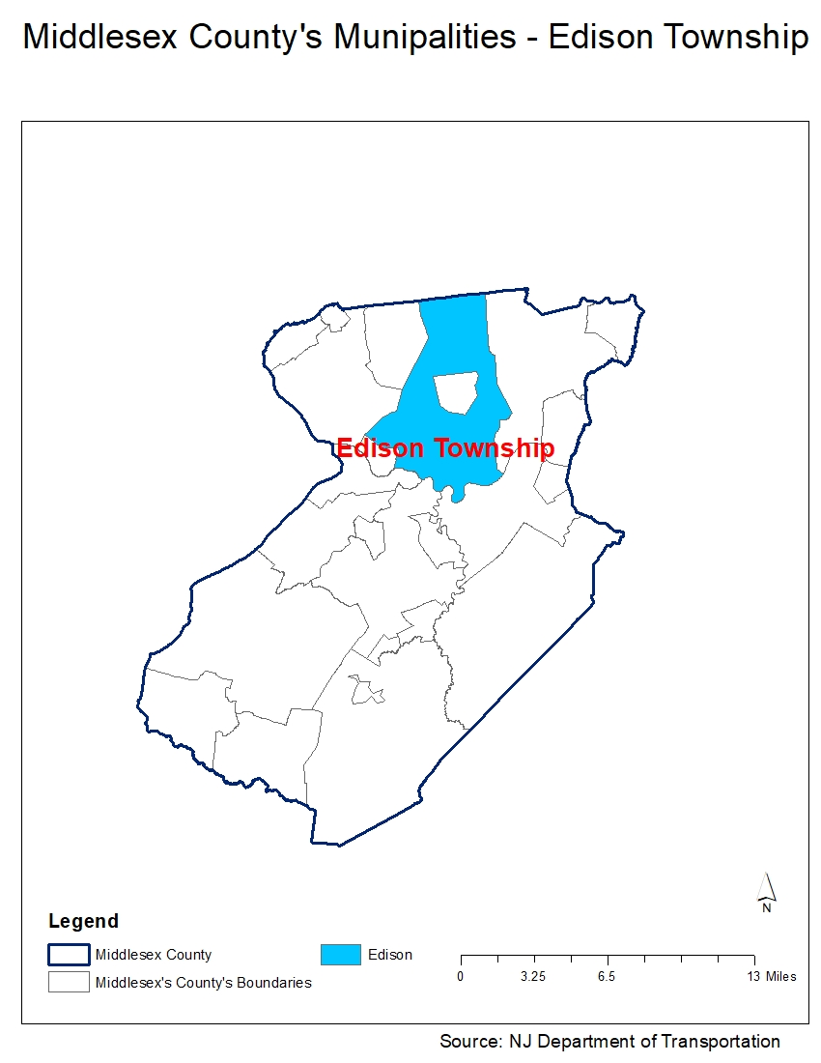
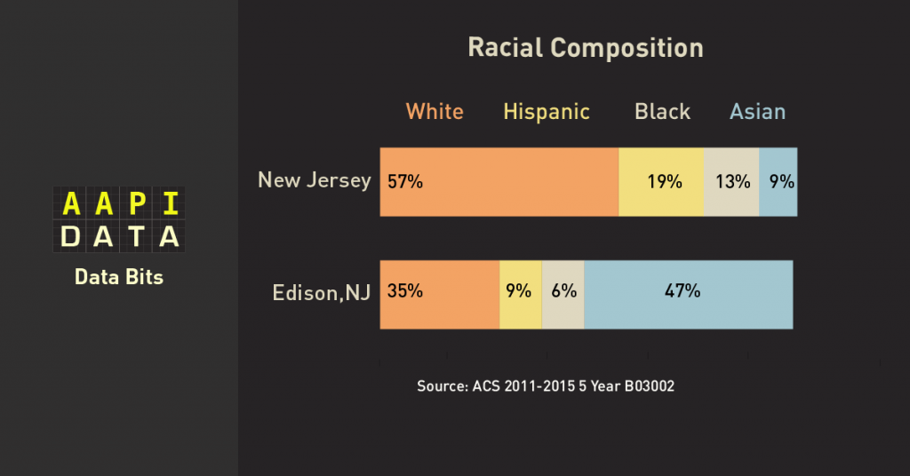
Edison
Metuchen and Highland park are derivatives of Edison Township
As of 2000 census, it is 5th densely populated town in the entire state of NJ
Nearly half of residents in Edison Are Asian
http://aapidata.com/blog/nearly-half-of-residents-in-edison-are-asian/

Slide 4
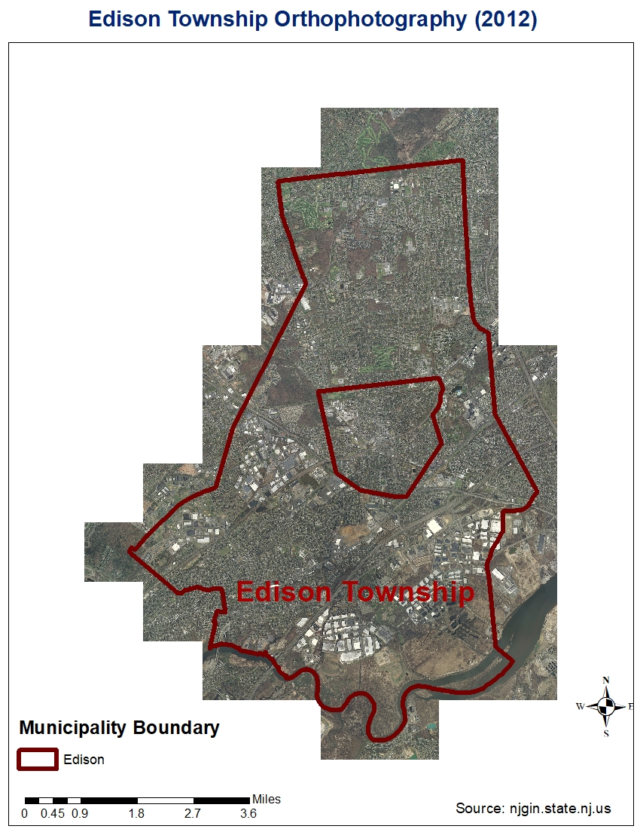
Orthophotography Edison

Slide 5
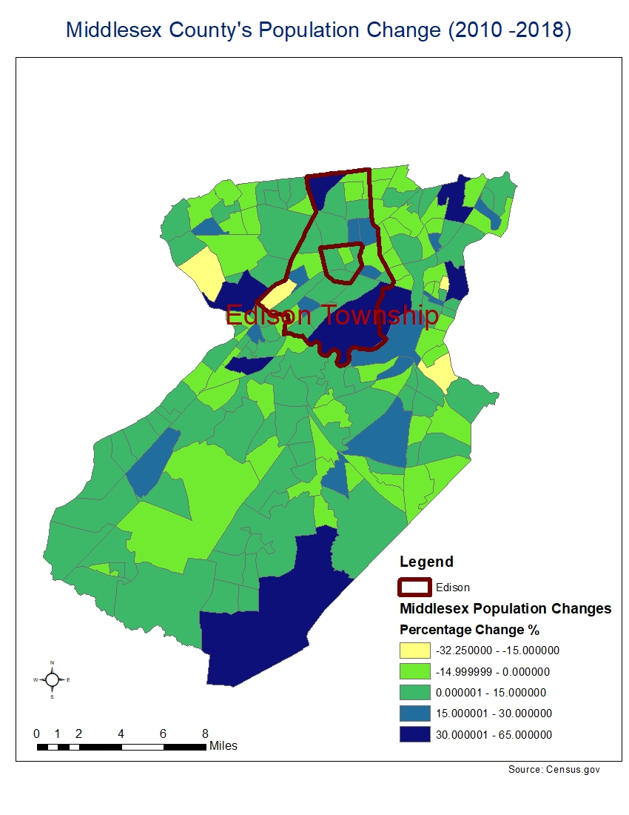
Population Change (2010-2018)
Compared to rest, Edison has been on the higher end of population increase

Slide 6
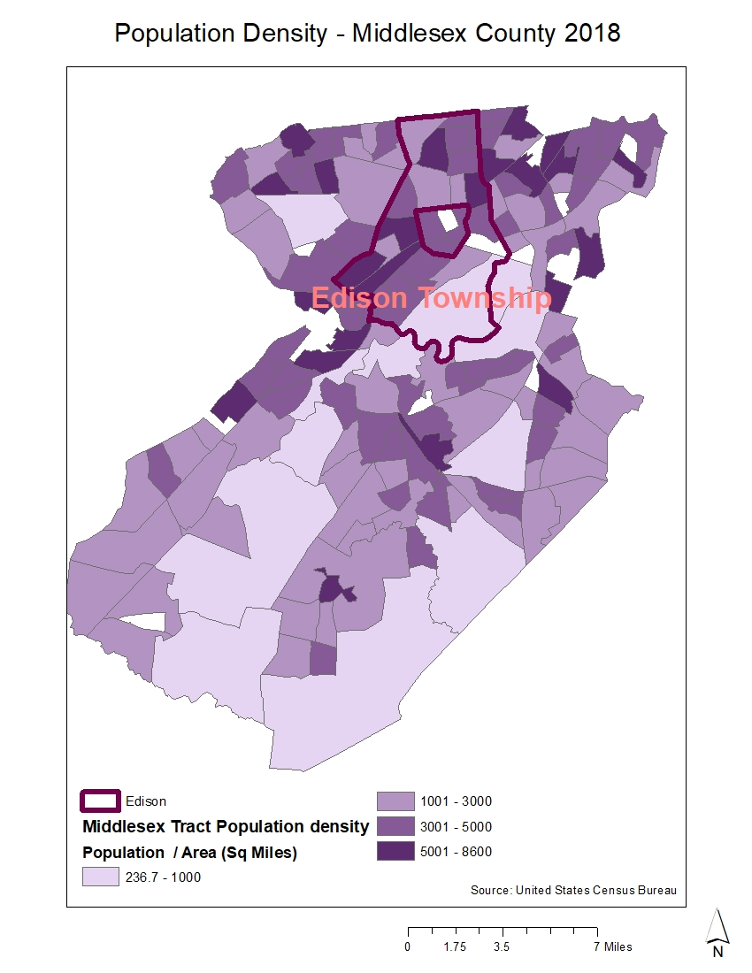
Population Density
Tracts of Edison have comparably higher density

Slide 7
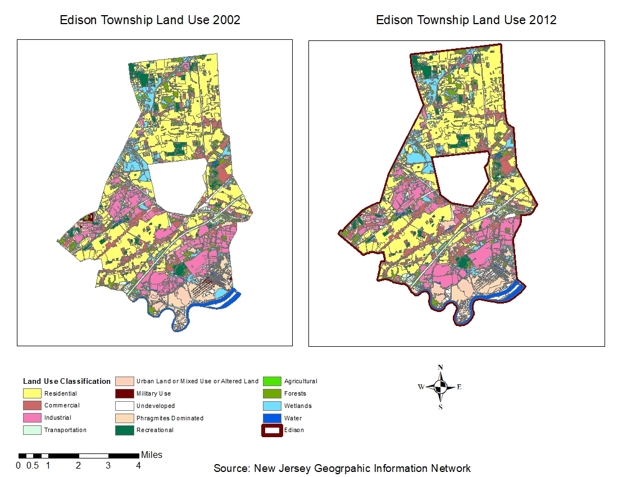
Land Use 2002 & 2012

Slide 8
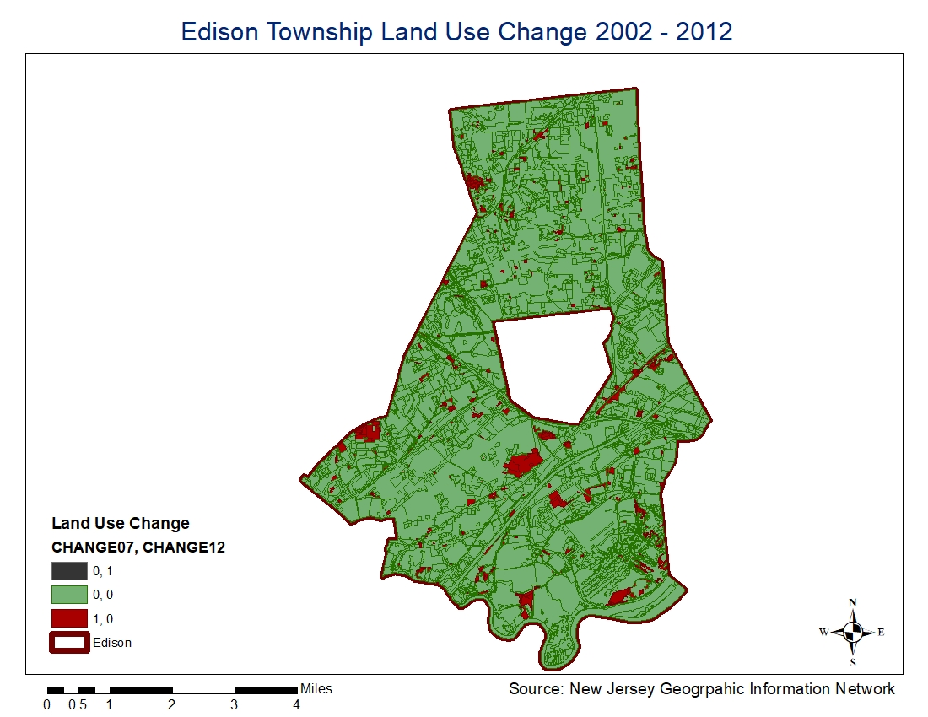
Land Use Change
Land Use change was not extensive in the span of 10 years
Deforestation in the north west
Complete exit of military installments in south west of Edison
New Residential
Ex- Military Establishments
Industrial to Commercial

Slide 9
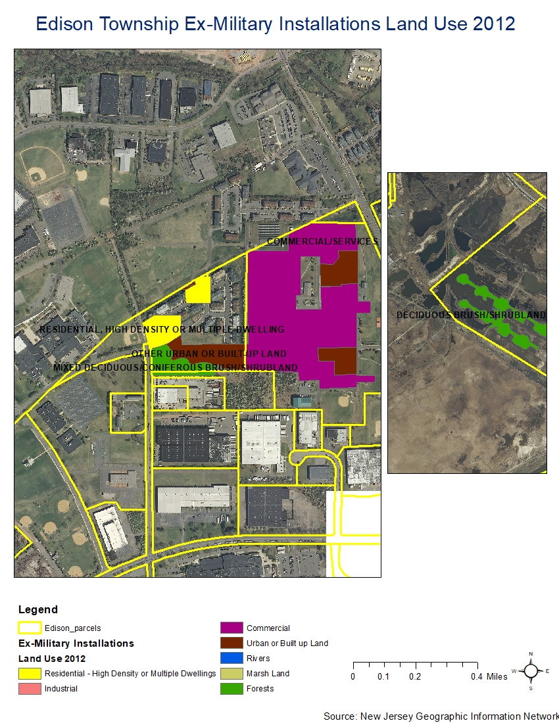
Edison Parcel Map of South West and South East
Military establishments converted into diverse sets of land uses

Slide 10
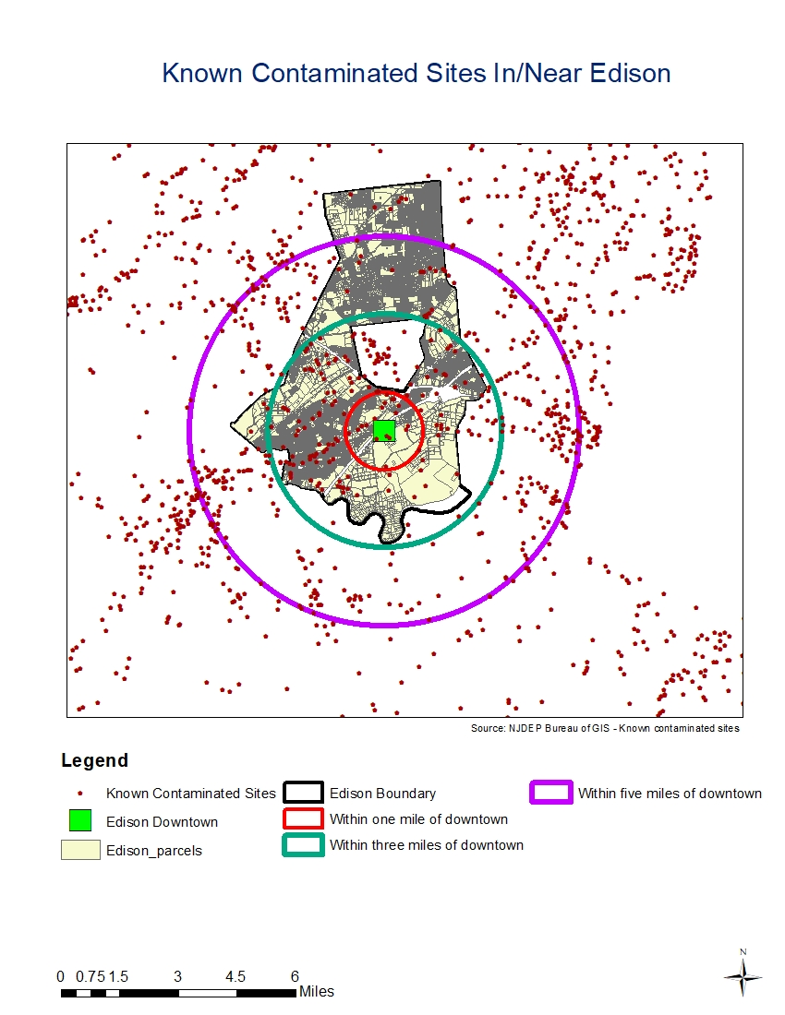
Contamination Sites around Edison
Approximately 700 contamination sites in Edison
Majority in Western region
Buffered Radius | Site Count
Within 1 miles | 18
Within 3 miles | 176
Within 5 miles | 502
Total Site Count | 696

Slide 11
EDISON TOWNSHIP – SOLAR ENERGY OUTLOOK
Solar Status-quo & potential, with respect to population, housing characteristics

Slide 12
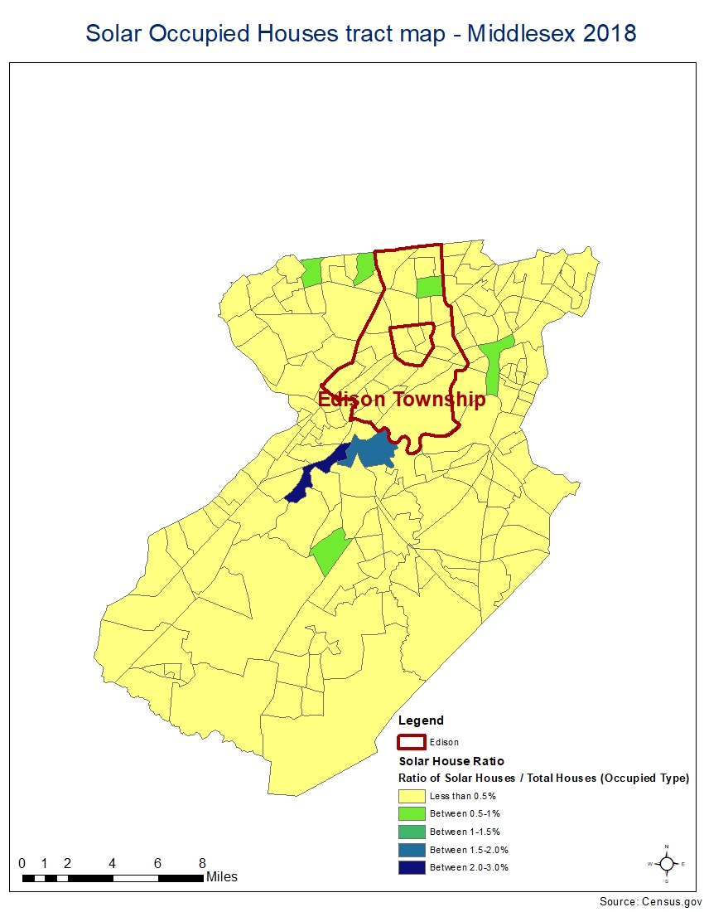
Census Variable Map I
Not many tracts in Middlesex have a high solar house ratio
Edison alone has only one that has more than 1 % solar house ratio
A lot of tracts in New Brunswick having high ratio

Slide 13
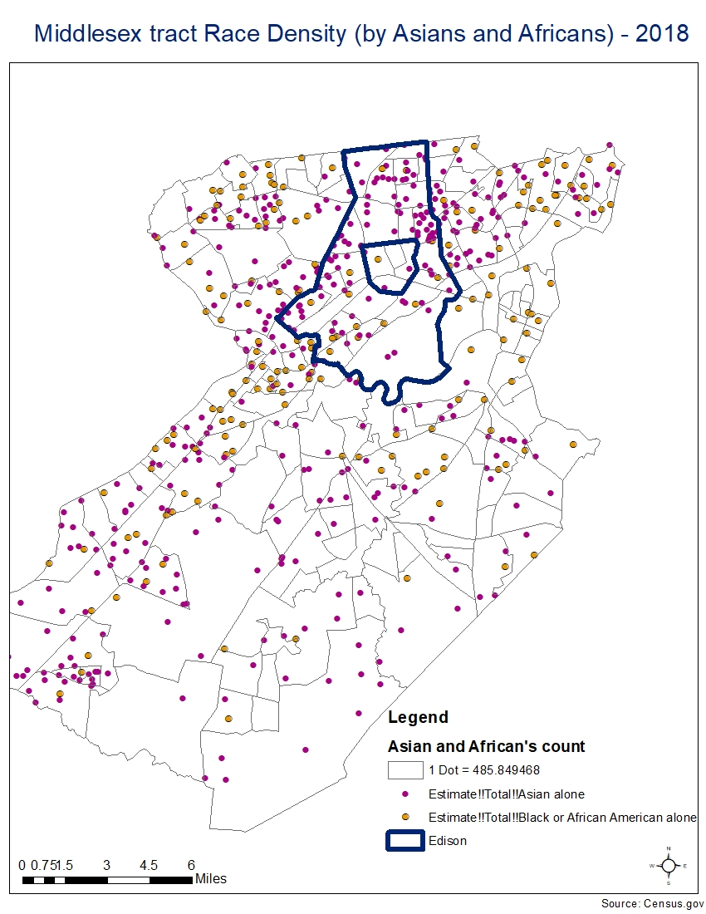
Census Variable Map II
Asians are more predominant in Edison whereas
Asians are a target race for encouraging solar roof adoption in Edison

Slide 14
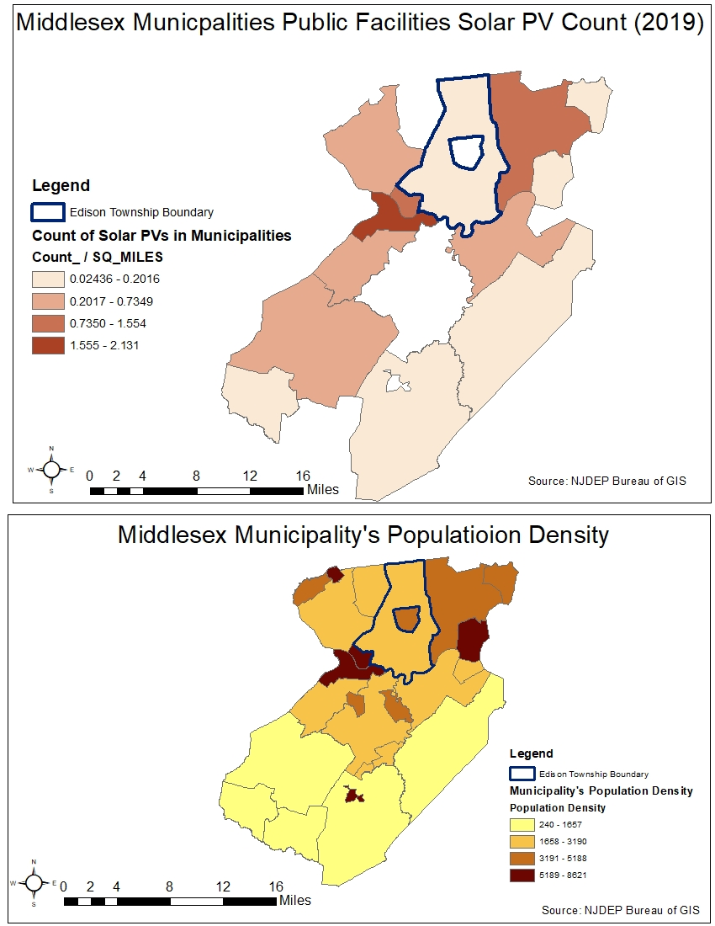
Solar Photovoltaics outlook
New Brunswick
Edison and New Brunswick are in stark comparison
With respect to population density of neighboring municipalities, Edison needs to have more solar pvs per public buildings
Map serves as a benchmark and a starting point
Dot density of Solar PVs will be shown later

Slide 15
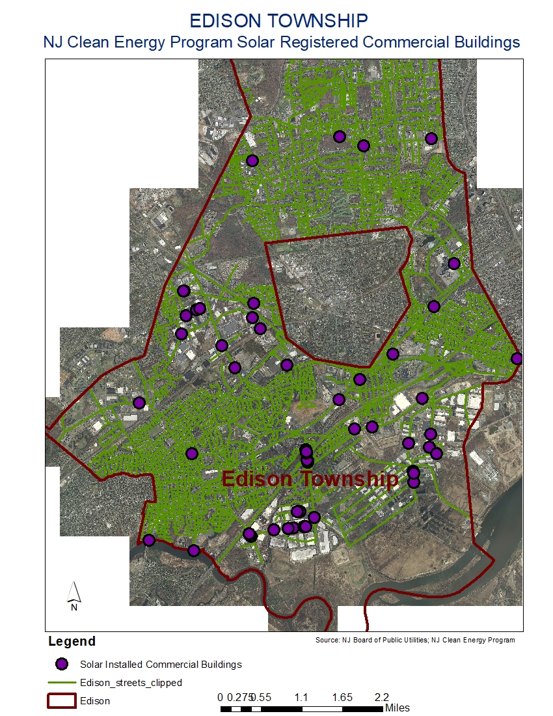
Geocoding Example using ArcMap
20 commercial buildings in Edison that have been registered in Clean Energy Program
Geocoding done using streets shapefile for NJ and the excel file for commercial building’s addresses as shown in next slide

Slide 16
Edison; Commercial Buildings; Installation Data; Aug 2020
Registration Number | SRP Project Number | Program | Premise Last Name | Premise Company | Premise Installation Address (Commercial Only) | Premise City | Premise Zip | County Code | PTO Date (Interconnection Date) | Calculated Total System Size
NJSRRE1532179724 | SRP07708 | Solar Registration Program | AVIDAN | 180 RARITAN CENTER LLC | 180 RARITAN CENTER PARKWAY | EDISON | 08837 | 11 | 6/7/2012 | 446.25
NJSRRE1532225196 | SRP05305 | Solar Registration Program | ADLER | ADLER DEVELOPMENT | 160 RARITAN PKWY-EAST HALF | EDISON | 08818 | 11 | 9/22/2011 | 338
NJSRRE1532225194 | SRP05304 | Solar Registration Program | ADLER | ADLER DEVELOPMENT | 160 RARITAN PKWY-WEST HALF | EDISON | 08818 | 11 | 9/22/2011 | 354.9
NJSRRE1532164375 | REIPNR-09167 | Solar Registration Program | ADLER | ADLER DEVELOPMENT | 151 FIELDCREST AVE | EDISON | 08837 | 11 | 9/7/2010 | 494.208
NJSRRE1532224440 | SRP05303 | Solar Registration Program | ADLER | ADLER DEVELOPMENT | 64 BRUNSWICK RD | EDISON | 08818 | 11 | 8/29/2011 | 644.84
NJSRRE1532376543 | REIPR-05435 | Solar Registration Program | WELSH | AEL GROUP LLC | 777 NEW DURHAM ROAD | EDISON | 08817 | 11 | 12/21/2009 | 30.275
NJSRRE1534688631 |  | Solar Registration Program | MICHAELSON | AMAZON.COM.DEDC.LLC | 2170 Route 27 | Edison | 08817 | 11 | 6/27/2018 | 4112.55
NJSRRE1532179722 | SRP07704 | Solar Registration Program | AVIDAN | AVI DON MANAGEMENT LLC | 180 RARITAN CENTER PARKWAY | EDISON | 08837 | 11 | 6/6/2012 | 399.84
NJSRRE1532179726 | SRP07720 | Solar Registration Program | AVIDAN | AVI DON MANAGEMENT LLC | 180 RARITAN CENTER PARKWAY | EDISON | 08837 | 11 | 6/6/2012 | 1335.18
NJSRRE1532167554 | SRP01019 | Solar Registration Program | AVIDAN | AVIDAN ENERGY SOLUTIONS LLC | 145 TALMADGE RD. | EDISON | 08817 | 11 | 3/28/2011 | 1999.92
NJSRRE1532166408 | REIPNR-08981 | Solar Registration Program | AVIDAN | AVIDAN ENERGY SOLUTIONS, LLC | 145 TALMADGE RD | EDISON | 08817 | 11 | 4/26/2011 | 2258.88
NJSRRE1532181686 | SRP09794 | Solar Registration Program | EICHEN | BARBILL ASSOCIATES | 40 ETHEL ROAD | EDISON | 08817 | 11 | 7/12/2012 | 62.64
NJSRRE1532175021 | SRP06238 | Solar Registration Program | LAMPARELLO | BEACON 629 LLC | 629 AMBOY AVE | EDISON | 08837 | 11 | 2/28/2012 | 55.08
NJSRRE1532188875 | SRP09238 | Solar Registration Program | PARACHA | BEST FOODS INC. | 75 MIDVALE RD | EDISON | 08817 | 11 | 9/11/2012 | 349.83
NJSRRE1532172634 | SRP04238 | Solar Registration Program | SZURA | BUCKHEAD BEEF COMPANY | 220 RARITAN CENTER PARKWAY | EDISON | 08837 | 11 | 11/30/2011 | 128.31
NJSRRE1532216941 | SRP38369 | Solar Registration Program | CIULLO | BUILDERS GENERAL SUPPLY CO | 1177 INMAN AVE | EDISON TWP | 08820 | 11 | 5/30/2015 | 78
NJSRRE1533885317 |  | Solar Registration Program | Pikarski | C&A Marketing, Inc. | 114 Tived Ln E | Edison | 08837 | 11 | 8/30/2017 | 999.79
NJSRRE1532189696 | SRP14883 | Solar Registration Program | PATEL | CHETAK NEW YORK LLC | 351 MILL RD | EDISON TWP | 08837 | 11 | 2/4/2013 | 406
NJSRRE1532183055 | SRP10975 | Solar Registration Program | PROFACI | COLAVITA USA | 1 1 RUNYONS LANE | EDISON TOWNSHIP | 08817 | 11 | 9/10/2012 | 816.2

Slide 17
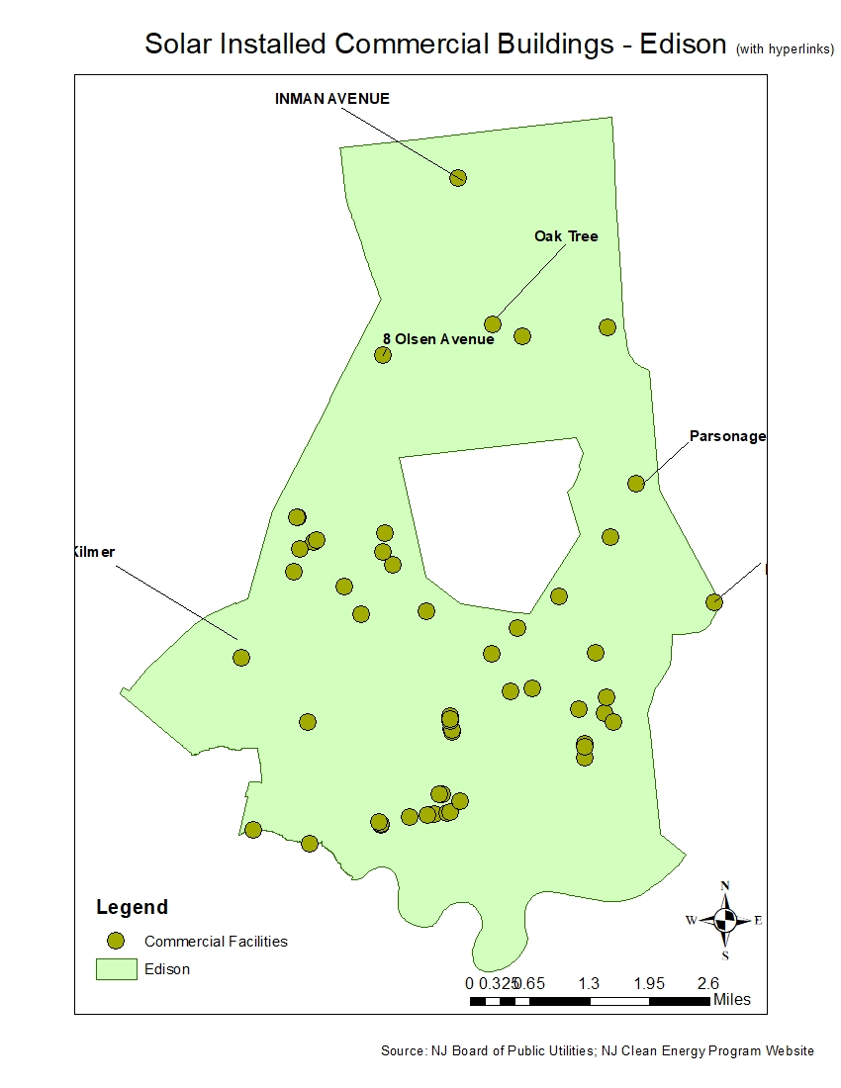
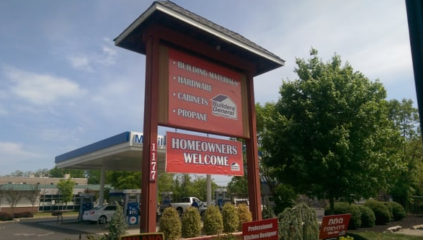
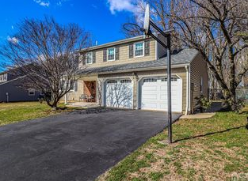
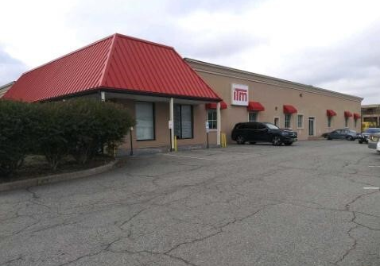
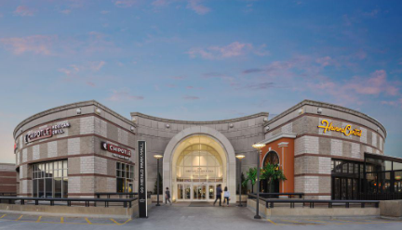
Hyperlinks of Commercial Buildings
https://njcleanenergy.com/renewable-energy/project-activity-reports/solar-activity-report-archive

Slide 18
Edison vs the rest in Middlesex
https://storymaps.arcgis.com/stories/69c76f955a3b4c6f8053ce74ad6f348e

